Slide 1




Slide 2

Find the Greatest Common Divisor of an Array

Slide 3
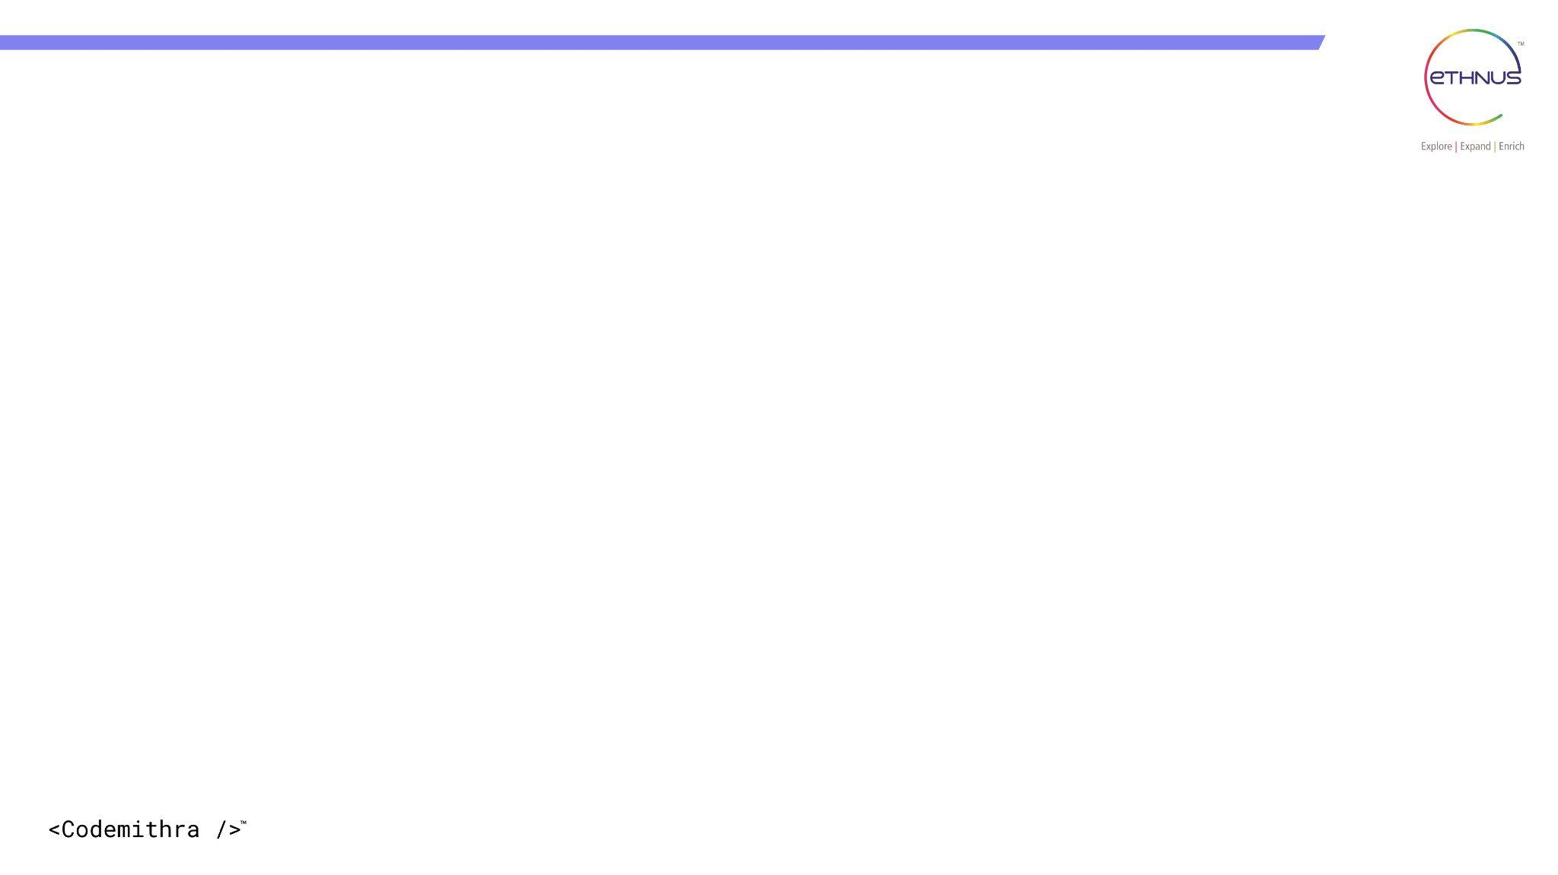

TOPICS
Introduction to Arrays
Types of Arrays
GCD of an array
Examples for GCD of an array
Approaches for GCD of an array
GCD of an array - Efficiency Comparison
Algorithm for finding GCD of an array
Recursive and Iterative Euclidean Approach
Time and Space Complexity
Real Time Applications
GCD & LCM Based Problem
GCD Subarray Problem

Slide 4
Introduction to Arrays
Definition:
A Single Dimensional Array is a linear collection of elements of the same data type, stored in contiguous memory locations.
It is also called a one-dimensional array and is often used to store lists of values like marks, names, temperatures, etc.
Declaration Syntax:
data_type[] array_name;
OR
data_type array_name[];
Initialization Syntax:
array_name = new data_type[size];

Slide 5
Types of Array
Arrays can be classified based on dimensions and structure.
1. One-Dimensional Array (1D Array) - Linear, single index
2. Two-Dimensional Array (2D Array) - Rows & columns
3. Multi-Dimensional Array - More than 2 dimensions
4. Static Array - Fixed size
5. Dynamic Array - Resizable
6. Jagged Array (Irregular Array) - Unequal row sizes
7. Sparse Array - Mostly zero values

Slide 6
Finding Greatest Common Divisor of an Array
Definition:
The Greatest Common Divisor (GCD) of an array is the largest number that divides all the elements of the array without leaving a remainder. In simple terms, it is the biggest number that all array elements are divisible by.
It is also called HCF (Highest Common Factor). Example: Let’s take the array: arr = [12, 24, 36] Now,GCD(12, 24) = 12 GCD(12, 36) = 12 So, GCD of the entire array is 12

Slide 7
GCD of an Array
Problem Statement
You are given an array of N positive integers. Your task is to compute the Greatest Common Divisor (GCD) of all the elements in the array.
The GCD of a set of integers is defined as the largest positive integer that divides each element of the array without leaving a remainder.Write a program to determine and print the GCD of the given array.
Input Format
The first line contains a single integer N, representing the number of elements in the array.
The second line contains N space-separated positive integers representing the array elements.
Output Format
Print a single integer — the GCD of all elements in the array.
Asked in TCS Digital (2024)

Slide 8
Examples for GCD of an Array
Sample Input 1
5
12 24 18 30 6
Sample Output 1
6
Explanation
Start with first element: gcd = 12
gcd(12, 24) = 12
gcd(12, 18) = 6
gcd(6, 30) = 6
gcd(6, 6) = 6
Final GCD = 6

Slide 9
Examples for GCD of an Array
Sample Input 2
3
7 11 13
Sample Output 2
1
Explanation
7, 11, 13 are all prime numbers
No common factor except 1 GCD = 1

Slide 10
Approaches for GCD of an array
Brute Force Approach - Check every number from min element → 1 and return the largest number dividing all elements
Iterative Euclidean Algorithm (Pairwise Reduction) - Start with first element keep doing gcd = gcd(gcd, next element)
Recursive Euclidean Algorithm - Apply recursively for array gcd(a, b) = gcd(b, a % b)
Functional Programming Approach - Convert array → stream
Prime Factorization Approach - Break numbers into prime factors and take common factors with minimum power
Divide and Conquer Approach - Split array into halves, find GCD of each half and Combine results

Slide 11
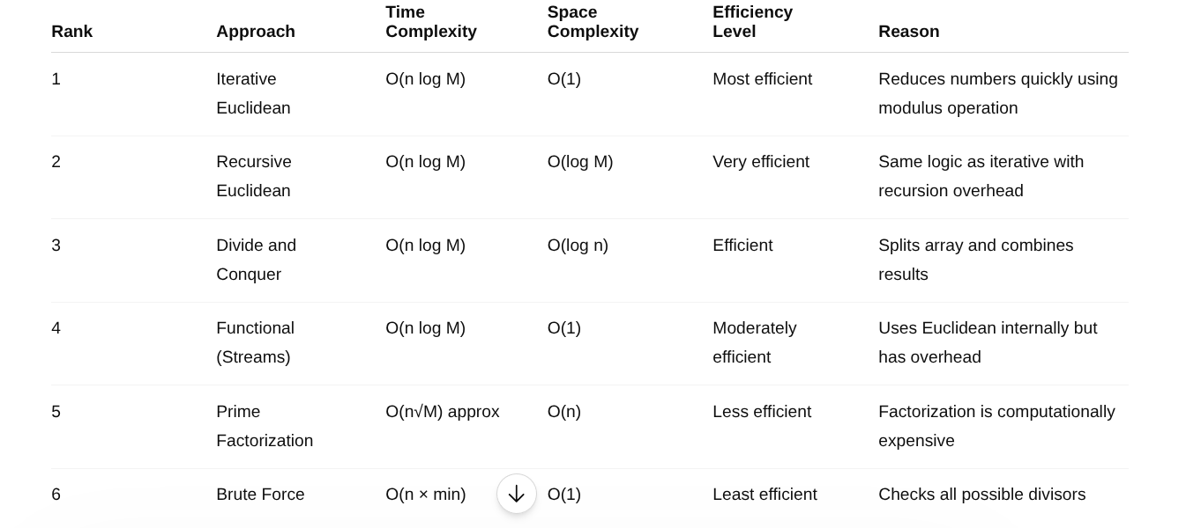
GCD of Array – Efficiency Comparison

Slide 12
Euclidean Algorithm for finding GCD of an Array
Read the size of the array N
Read all N elements into the array A
Initialize a variable result with the first element of the array A[0]
Traverse the array starting from the second element to the last element 1. For each element, compute result = gcd(result, A[i]) using Euclidean method 2. If at any step the value of result becomes 1, stop further computation early
Continue the process until all elements are processed or early termination occurs
Print or return the final value stored in result as the GCD of the array

Slide 13
Java Code for GCD of an Array - Recursive Euclidean Approach
import java.util.Scanner;
public class Main {
static int findGCD(int a, int b) {
if (b == 0)
return a;
return findGCD(b, a % b);
} // Function to find GCD of array
static int findArrayGCD(int[] arr) {
int result = arr[0];
for (int i = 1; i < arr.length; i++) {
result = findGCD(result, arr[i]);
if (result == 1)
return 1;
} return result;
}
public static void main(String[] args) {
Scanner sc = new Scanner(System.in);
int n = sc.nextInt();
int[] arr = new int[n];
for (int i = 0; i < n; i++) {
arr[i] = sc.nextInt();
}
int gcd = findArrayGCD(arr);
System.out.println(gcd);
sc.close(); } }

Slide 14
Euclidean Algorithm - Code Explanation
Explanation of Code:
findGCD(a, b): Uses recursion and Euclidean algorithm to compute the GCD of two numbers.
findArrayGCD(arr): Iterates over the array, keep updating the GCD of the array from left to right.
Early exit: If GCD becomes 1, we return early because 1 is the smallest possible GCD.
In main(): We pass the array and print the result.

Slide 15
Time and Space Complexity – GCD of Array (Recursive)
Time Complexity
The GCD of two numbers using Euclidean Algorithm takes O(log M), where M = larger number
For an array of n elements, GCD is computed sequentially for all elements
Each element contributes a logarithmic cost
Space Complexity
Input array stores n elements → O(n)
Recursion stack for GCD function takes O(log M)
Final Time Complexity: O(n log M)
Final Space Complexity: O(n)

Slide 16
Java Code for GCD of an Array - Iterative Euclidean Approach
import java.util.Scanner;
public class Main {
static int findGCD(int a, int b) {
while (b != 0) {
int temp = b;
b = a % b;
a = temp; }
return a; }
static int findArrayGCD(int[] arr) {
int result = arr[0];
for (int i = 1; i < arr.length; i++) {
result = findGCD(result, arr[i]);
if (result == 1)
return 1; }
return result; }
public static void main(String[] args) {
Scanner sc = new Scanner(System.in);
int n = sc.nextInt();
int[] arr = new int[n];
for (int i = 0; i < n; i++) {
arr[i] = sc.nextInt(); }
int gcd = findArrayGCD(arr);
System.out.println(gcd);
sc.close(); } }

Slide 17
Time and Space Complexity – GCD of Array (Iterative)
Time Complexity
Array traversal runs for n elements → O(n)
Each iterative GCD computation takes O(log M)
Space Complexity
Uses only a few variables
No recursion stack is used
Final Time Complexity: O(n log M)
Final Space Complexity: O(1)

Slide 18
Real Time Applications
Network Packet Synchronization Finds the largest common transmission interval for multiple devices in communication systems.
Audio & Video Processing Used to synchronize different sampling rates and frame rates efficiently.
Cryptography & Cybersecurity Core concept in RSA encryption, modular arithmetic, and secure key generation.
Parallel Computing & Task Scheduling Determines optimal chunk sizes and common execution cycles among processors.
Image Processing & Screen Resolution Scaling Simplifies aspect ratios like 1920×1080 → 16:9 using GCD.

Slide 19
Real Time Applications
Traffic Signal Coordination Finds common timing intervals for synchronizing traffic lights.
Database Sharding & Storage Allocation Used to evenly partition data blocks and storage units.
Game Development Helps in map tiling, grid alignment, animation cycles, and movement synchronization.
Robotics & Embedded Systems Synchronizes repeated sensor readings and motorcycles efficiently.
Manufacturing & Cutting Optimization Helps cut materials into maximum equal-sized pieces with zero wastage.

Slide 20
GCD & LCM Based Problem
Problem Statement
You are given two integers G and L representing the GCD and LCM of two numbers respectively.Your task is to determine whether it is possible to find two positive integers whose, Greatest Common Divisor (GCD) is G and Least Common Multiple (LCM) is L. If possible, print any such pair of numbers. Otherwise, print -1.
Input Format
First line contains integer G
Second line contains integer L
Output Format
Print two space-separated integers representing the pair
If no such pair exists, print -1
Infosys SP OA (2025 & 2026)

Slide 21
GCD & LCM Based Problem
Constraints
1 ≤ G, L ≤ 10^9
Sample Input 1
4
24
Sample Output 1
4 24
Explanation
GCD(4, 24) = 4
LCM(4, 24) = 24
Sample Input 2
5
14
Sample Output 2
-1
Explanation
No pair exists because:
14 mod 5 ≠ 0
So LCM is not divisible by GCD.

Slide 22
Number Theory Approach for GCD & LCM Based Problem
import java.util.Scanner;
public class Main {
public static void main(String[] args) {
Scanner sc = new Scanner(System.in);
int G = sc.nextInt();
int L = sc.nextInt();
if (L % G != 0) {
System.out.println(-1);
}
else {
System.out.println(G + " " + L);
}
sc.close();
}
}
Time Complexity : O(1)
Space Complexity : O(1)

Slide 23
GCD Subarray Problem
Problem Statement
A network security team monitors packets represented as an array of integers. A communication segment is considered stable if the common synchronization factor among all packets in that segment is greater than 1.
The team is allowed to modify at most k packets in the system.
Your task is to determine the minimum length continuous communication segment that can become stable after performing at most k modifications.
Formally, find the minimum length contiguous subarray whose GCD can become greater than 1. If no such segment exists, print -1.
Asked in Amazon (2025)

Slide 24

GCD Subarray Problem
Input Format
First line contains integer n — number of packets
Second line contains n space-separated integers
Third line contains integer k
Output Format
Print the minimum length of the required
contiguous subarray
Constraints
1 ≤ n ≤ 10^5
1 ≤ nums[i] ≤ 10^9
0 ≤ k ≤ n

Slide 25
GCD Subarray Problem
Sample Input
5
2 2 4 9 6
1
Sample Output
1
Explanation
Subarray [2] already has GCD greater than 1
Minimum possible length is 1

Slide 26
Brute Force Subarray Traversal + Running GCD
(Euclidean Algorithm)
import java.util.*;
public class Main {
static int gcd(int a, int b) {
while (b != 0) {
int temp = b;
b = a % b;
a = temp;}
return a;}
public static void main(String[] args) {
Scanner sc = new Scanner(System.in);
int n = sc.nextInt();
int[] arr = new int[n];
for(int i=0;i<n;i++) {
arr[i] = sc.nextInt();}
int k = sc.nextInt();
int ans = Integer.MAX_VALUE;
for(int i=0;i<n;i++) {
int g = 0;
for(int j=i;j<n;j++) {
g = gcd(g, arr[j]);
if(g > 1) {
ans = Math.min(ans, j-i+1);
}}}
System.out.println(ans == Integer.MAX_VALUE ? -1 : ans); sc.close(); }}

Slide 27
Time and Space Complexity
Time Complexity
n² → generating all subarrays
log M → GCD computation using Euclidean Algorithm
Space Complexity
Uses only constant extra variables
No extra data structures are used
Time Complexity : O(n² log M)
Space Complexity : O(1)

Slide 28
Interview questions
Asked in Amazon (2026) - MCQ
Which algorithm is most commonly used to find the GCD of two numbers efficiently?
A) Binary Search B) Euclidean Algorithm C) Merge Sort D) BFS
Answer : B) Euclidean Algorithm

Slide 29
Interview questions
Asked in Goldman Sachs (2025) - MCQ
To find the GCD of an array of N elements, the optimal approach is to:
A) Compare every pair of elements B) Sort the array first C) Compute GCD cumulatively from left to right D) Use Dynamic Programming
Answer : C) Compute GCD cumulatively from left to right

Slide 30
Interview questions
Asked in Zoho (2026) - MCQ
During array GCD computation, if the current GCD becomes 1, what can be done?
A) Continue checking all elements compulsorily B) Stop immediately since final GCD cannot become smaller than 1 C) Sort the array D) Reverse the array
Answer : B) Stop immediately since final GCD cannot become smaller than 1

Slide 31
Interview questions
You are given an array of positive integers. How will you optimize GCD calculation to stop early?
Answer:
If at any point, GCD == 1, we can stop further checks. Reason: 1 is the minimum GCD possible, and no further calculation can reduce it.
Code Form
if (result == 1) return 1;

Slide 32
Interview questions
Why is the Euclidean algorithm preferred for finding the GCD of two numbers?
Answer:
It reduces the problem size significantly using modulo:
Instead of checking all divisors, it reduces to: GCD(a, b) = GCD(b, a % b)
Much faster and efficient: O(log min(a, b))

Slide 33
Interview questions
Given arr = [72, 108, 180, 252], write the steps to compute the GCD of the array.
Answer:
Step 1: GCD(72, 108) = 36
Step 2: GCD(36, 180) = 36
Step 3: GCD(36, 252) = 36
GCD is = 36

Slide 34
Interview questions
What is the time and space complexity of finding the GCD of an array with n elements using the Euclidean Algorithm?
Answer:
Time Complexity: O(n * log M) (where M = max element in the array)
Space Complexity:
Recursive: O(log M) Iterative: O(1)

Slide 35
Interview questions
What is the Greatest Common Divisor (GCD) of an array?
Give a real-world scenario where GCD helps in solving problems.
Answer: GCD of an array is the largest number that divides all elements of the array without leaving a remainder.
Real-world Use Case: To split something equally — like cutting wires of different lengths into equal pieces without waste.

Slide 36


Help Desk
Any concerns related to attendance/marks/ faculty ; you can reach out to ETHNUS helpdesk through the displayed QR code
https://codemithra.com/vit-helpdesk/

Slide 37

https://learn.codemithra.com

Slide 38




THANK YOU
+91 78150 95095
codemithra@ethnus.com
www.codemithra.com

